Slide 1
jQuery Animate
Selva kumar S
Assistant Professor, Department of CS&E
selva.cse@bmsce.ac.in

Slide 2
Demo URL
http://james.padolsey.com/
http://slideme.luigiferraresi.it/
http://lab.aerotwist.com/canvas/fireworks/
http://tympanus.net/Development/GammaGallery/
http://tympanus.net/Tutorials/SlideshowJmpress/
http://www.jqueryrain.com/?3N9zfyBK
http://www.jqueryrain.com/?7P0JlS62
http://www.jqueryrain.com/?y2bnNysq
http://www.jqueryrain.com/?wE84jw_V
http://waitanimate.eggbox.io/#/

Slide 3
http://tympanus.net/Tutorials/ItemBlur/
http://git.blivesta.com/animsition/rotate-sm/
http://www.jquery-az.com/jquery/demo.php?ex=9.0_1
http://tympanus.net/Tutorials/AnimatedTextIconMenu/example1.html
http://tympanus.net/Tutorials/AnimatedSkillsDiagram/
http://viralpatel.net/blogs/understanding-jquery-animate-function/
http://bxslider.com/examples/thumbnail-pager-2

Slide 4
jQuery Effects
jQuery provides a trivially simple interface for doing various kind of amazing effects.
jQuery methods allow us to quickly apply commonly used effects with a minimum configuration.

Slide 5
JQuery Effect Methods
animate( params, [duration, easing, callback] )
A function for making custom animations.
fadeIn( speed, [callback] )
Fade in all matched elements by adjusting their opacity and firing an optional callback after completion.
fadeOut( speed, [callback] )
Fade out all matched elements by adjusting their opacity to 0, then setting display to "none" and firing an optional callback after completion.
fadeTo( speed, opacity, callback )
Fade the opacity of all matched elements to a specified opacity and firing an optional callback after completion.
hide( )
Hides each of the set of matched elements if they are shown.
hide( speed, [callback] )
Hide all matched elements using a graceful animation and firing an optional callback after completion.

Slide 6
JQuery Effect Methods (Contd.)
show( )
Displays each of the set of matched elements if they are hidden.
show( speed, [callback] )
Show all matched elements using a graceful animation and firing an optional callback after completion.
slideDown( speed, [callback] )
Reveal all matched elements by adjusting their height and firing an optional callback after completion.
slideToggle( speed, [callback] )
Toggle the visibility of all matched elements by adjusting their height and firing an optional callback after completion.
slideUp( speed, [callback] )
Hide all matched elements by adjusting their height and firing an optional callback after completion.
stop( [clearQueue, gotoEnd ])
Stops all the currently running animations on all the specified elements.

Slide 7
JQuery Effect Methods (Contd.)
toggle( )
Toggle displaying each of the set of matched elements.
toggle( speed, [callback] )
Toggle displaying each of the set of matched elements using a graceful animation and firing an optional callback after completion.
toggle( switch )
Toggle displaying each of the set of matched elements based upon the switch (true shows all elements, false hides all elements).
jQuery.fx.off
Globally disable all animations.

Slide 8
animate() Method
The animate( ) method performs a custom animation of a set of CSS properties.
selector.animate( params, [duration, easing, callback] );
Parameters:
params: A map of CSS properties that the animation will move toward.
duration: This is optional parameter representing how long the animation will run.
easing: This is optional parameter representing which easing function to use for the transition.
Default value is "swing". Possible values:"swing" - moves slower at the beginning/end, but faster in the middle
"linear" - moves in a constant speed
callback: This is optional parameter representing a function to call once the animation is complete.

Slide 9
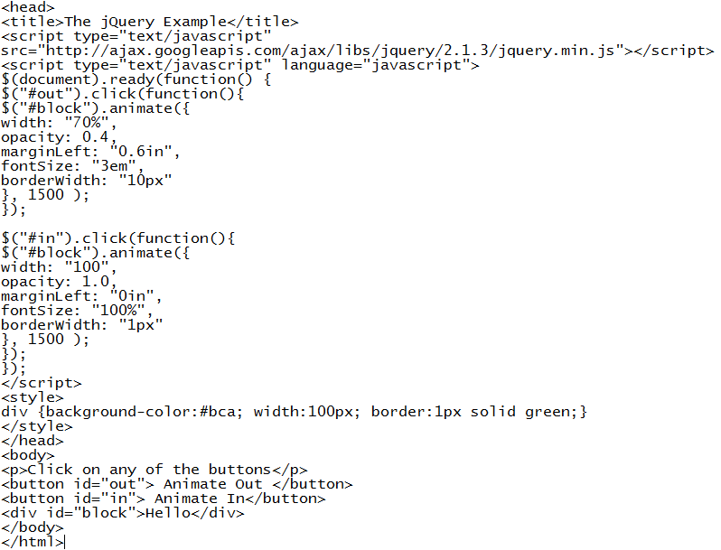

Example

Slide 10
fadeIn() & fadeOut Method
The fadeIn( ) method fades in all matched elements by adjusting their opacity and firing an optional callback after completion.
selector.fadeIn( speed, [callback] );
The fadeOut( ) method fades out all matched elements by adjusting their opacity to 0, then setting display to "none" and firing an optional callback after completion.
selector.fadeOut( speed, [callback] );

Slide 11
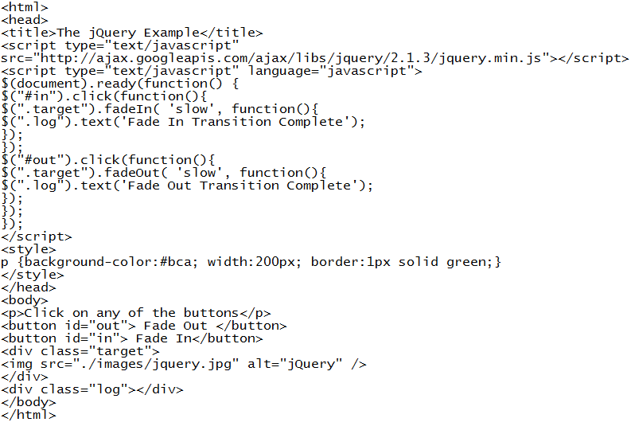
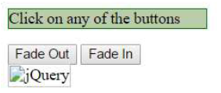
Example

Slide 12
fadeTo() Method
The fadeTo( ) method fades the opacity of all matched elements to a specified opacity and firing an optional callback after completion.
selector.fadeTo(speed, opacity[, callback]);

Slide 13
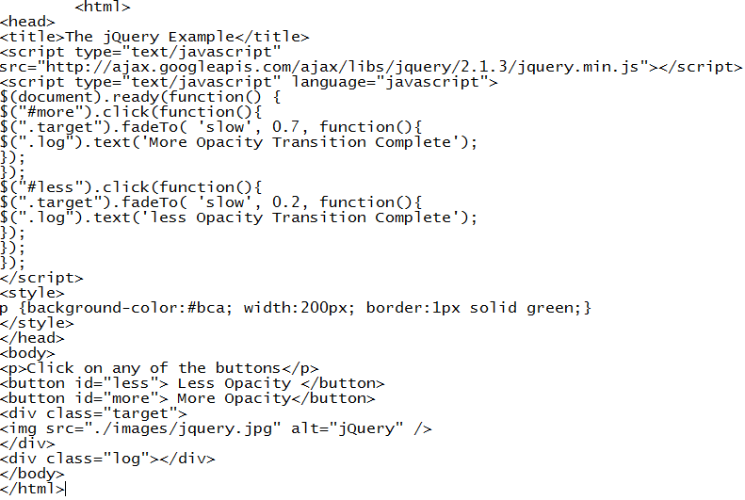
Example

Slide 14
Showing and Hiding Elements
syntax for show() method:
[selector].show( speed, [callback] );
syntax for hide() method:
[selector].hide( speed, [callback] );
speed: A string representing one of the three predefined speeds ("slow", "normal“,or "fast") or the number of milliseconds to run the animation (e.g. 1000).
callback: This optional parameter represents a function to be executed whenever the animation completes; executes once for each element animated against.

Slide 15
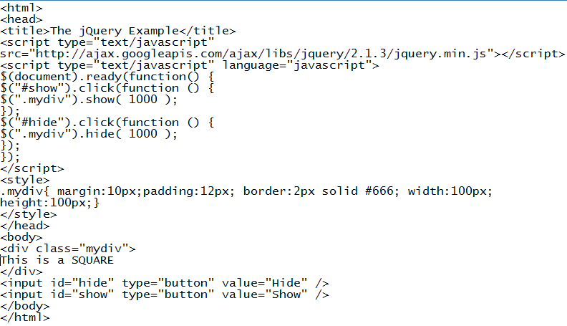
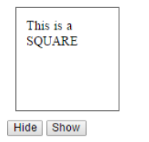
Example

Slide 16
Toggling the Elements
jQuery provides methods to toggle the display state of elements between revealed or hidden. If the element is initially displayed, it will be hidden; if hidden.
syntax for one of the toggle() methods:
[selector]..toggle([speed][, callback]);

Slide 17
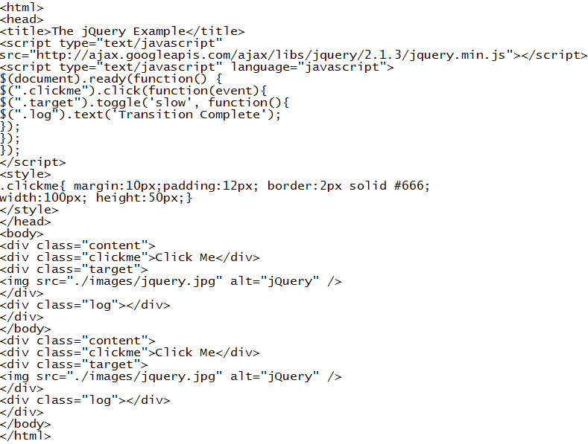
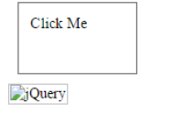
Example

Slide 18
slideDown() & slideUP() Method
The slideDown() method reveals all matched elements by adjusting their height and firing an optional callback after completion.
selector.slideDown( speed, [callback] );
The slideUp() method hides all matched elements by adjusting their height and firing an optional callback after completion.
selector.slideUp( speed, [callback] );

Slide 19
slideToggle() Method
The slideToggle() method toggles the visibility of all matched elements by adjusting their height and firing an optional callback after completion.
selector.slideToggle( speed, [callback] );

Slide 20
stop() Method
The stop( [clearQueue, gotoEnd ]) method stops all the currently running animations on all the specified elements.
selector.stop( [clearQueue], [gotoEnd] ) ;
parameters used by this method:
clearQueue: This is optional boolean parameter. When set to true clears the animation queue, effectively stopping all queued animations.
gotoEnd : This is optional boolean parameter. A Boolean (true/false) that when set to true causes the currently playing animation to immediately complete, including resetting original styles on show and hide and calling the callback function.

Slide 21
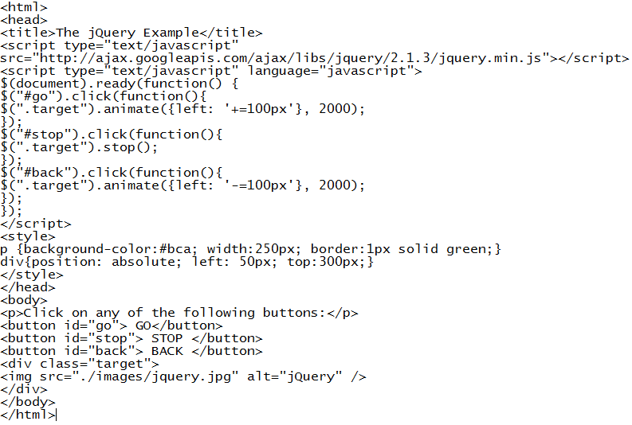
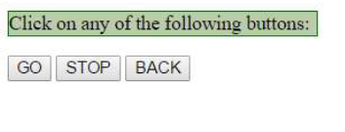
Example

Slide 22
jQuery.fx.off() Method
The jQuery.fx.off() method globally disables all the animations.
jQuery.fx.off = [true | false ] ;
The parameters used by this method:
Boolean This should be set to either false to enable the animations or to true to disable the animations globally.

Slide 23
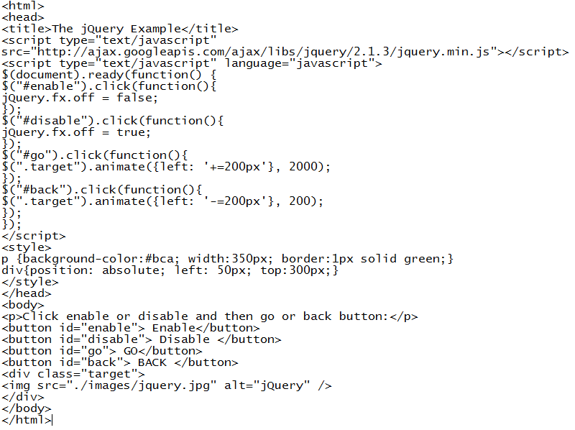
Example

Slide 24
UI Library Based Effects
To use these effects you can either download latest jQuery UI Library jquery-ui-1.11.4.custom.zip from jQuery UI Library or use Google CDN to use it in the similar way as we have done for jQuery.
<head>
<script src="https://ajax.googleapis.com/ajax/libs/jqueryui/1.11.3/jqueryui.min.js"></script>
</head>

Slide 25
Methods & Description
Blind
Blinds the element away or shows it by blinding it in.
Bounce
Bounces the element vertically or horizontally n-times.
Clip
Clips the element on or off, vertically or horizontally.
Drop
Drops the element away or shows it by dropping it in.
Explode
Explodes the element into multiple pieces.

Slide 26
Fold
Folds the element like a piece of paper.
Highlight
Highlights the background with a defined color.
Puff
Scale and fade out animations create the puff effect.
Scale
Shrink or grow an element by a percentage factor.
Shake
Shakes the element vertically or horizontally n-times.
Size
Resize an element to a specified width and height.

Slide 27

Assignment
Use the above discussed jQuery metods to simulate firework.

Slide 28
Further Study
www.tutorialpoint.com
www.tutorialrepublic.com

